Slide 1
Analysis on Location to Open Business

Slide 2
Business Problem
Identify a location either Toronto or New York to open a new business
We have been given a list of six business types which we would like to evaluate:
Bakery
Indian Restaurant
Mexican Restaurant
Italian Restaurant
Thai Restaurant
Hotel

Slide 3
Data
The Data Sets which we will use includes:
Publicly available census data from the two cities. We will correlate it with geo-spatial data. This will give us the ability to visualize this data
Four Square data to perform query for existing business types which fit this profile and first find out which city has the least business of this type. Four Square data will also give is counts for these business types in each neighborhood.

Slide 4
Methodology
In the first step we will try to identify which of these businesses has the least numbers in the city.
Our basic assumption is that all businesses have the same appeal and also all the neighborhoods have comparable population. We realize that in real world this may not be true, but we make this assumption to simplify the analysis.
Once we have identified the type of business, we will then start looking for geographic areas where this business has the least quantity so that we have the minimal competition.
With this data we will recommend to our client the geographic area which he should open his business in.
Further to reduce the number of calls, we will focus in the areas of Manhattan in NY and Downtown Toronto

Slide 5
Result: Count of New York Restaurants
Our analysis indicates that in Manhattan Indian and Thai restaurants are the least in numbers.
Venue Type: " Bakery " Number in Manhattan: 76
Venue Type: " Indian " Number in Manhattan: 33
Venue Type: " Italian " Number in Manhattan: 134
Venue Type: " Mexican " Number in Manhattan: 62
Venue Type: " Thai " Number in Manhattan: 26
Venue Type: " Hotel " Number in Manhattan: 74

Slide 6
Result: Count of Toronto Restaurants
Our analysis indicates that in Downtown Toronto, Indian restaurants are the least in numbers.
Venue Type: " Bakery " Number in Downtown Toronto: 36
Venue Type: " Indian " Number in Downtown Toronto: 11
Venue Type: " Italian " Number in Downtown Toronto: 40
Venue Type: " Mexican " Number in Downtown Toronto: 14
Venue Type: " Thai " Number in Downtown Toronto: 20
Venue Type: " Hotel " Number in Downtown Toronto: 45

Slide 7
Result
Our Analysis suggests that Indian restaurants are amongst the least in Toronto and Manhattans
Now let’s look at the geographic restaurants in both Manhattan and Downtown Toronto.
We have color coded the neighborhoods such that a red indicates that there is more than one restaurant in the neighborhood, while blue indicates that there is no restaurant in the neighborhood.

Slide 8
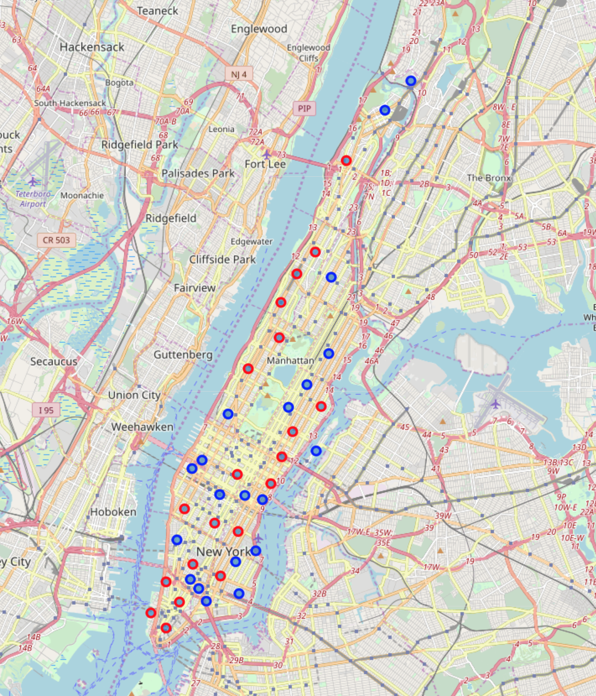
Manhattan Data

Slide 9
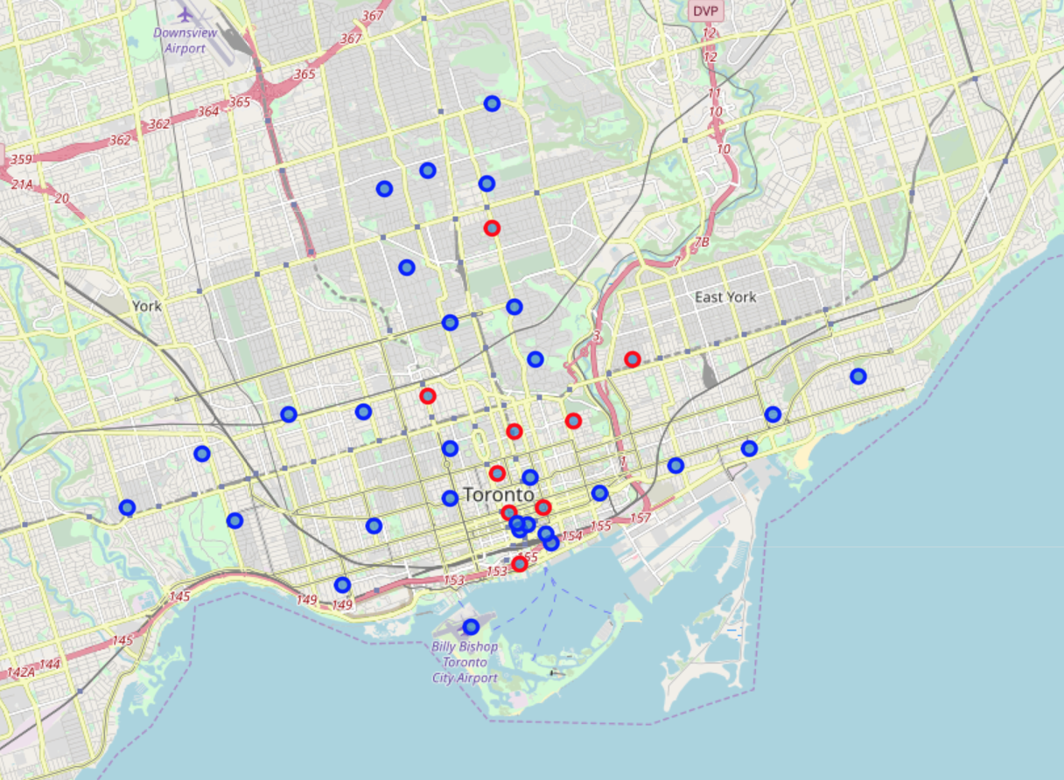
Toronto Data

Slide 10
Result
Our analysis shows that while in Manhattan the Indian restaurants are uniformly distributed, there are two potential areas in Toronto to open Indian restaurant.
These two cover multiple neighborhoods areas and these currently have no Indian restaurant. Our recommendation is to look at potential business sites in these two areas and find a venue which has the least cost of entry.

Slide 11
Recommendation
Open the restaurants in of the two areas

